Slide 1


RESIDENTIAL MAINTENANCE MANAGEMENT SYSTEM
PRESENTED BY:
Quin Perkins
Sandip Poudel
Tristan Kras
Bethlehem Tewodros
Iteration 4

Slide 2

1
Property maintenance request system
Project Overview
2
built with Java 21, JavaFX, SQL
3
Agile Scrum Methodology
4
Three-tier architecture layers
(presentation, business logic, data access)

Slide 3
1
Notification System(email alerts)
Iteration 4 Goals
2
Admin Dashboard
3
Photo upload capability for maintenance tickets
4
Staff update with resolution text box in tickets

Slide 4
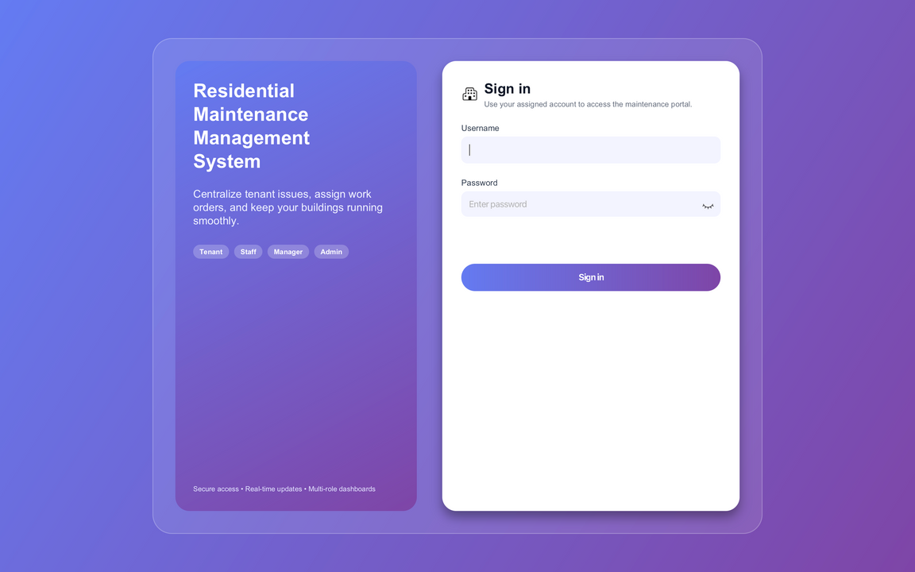
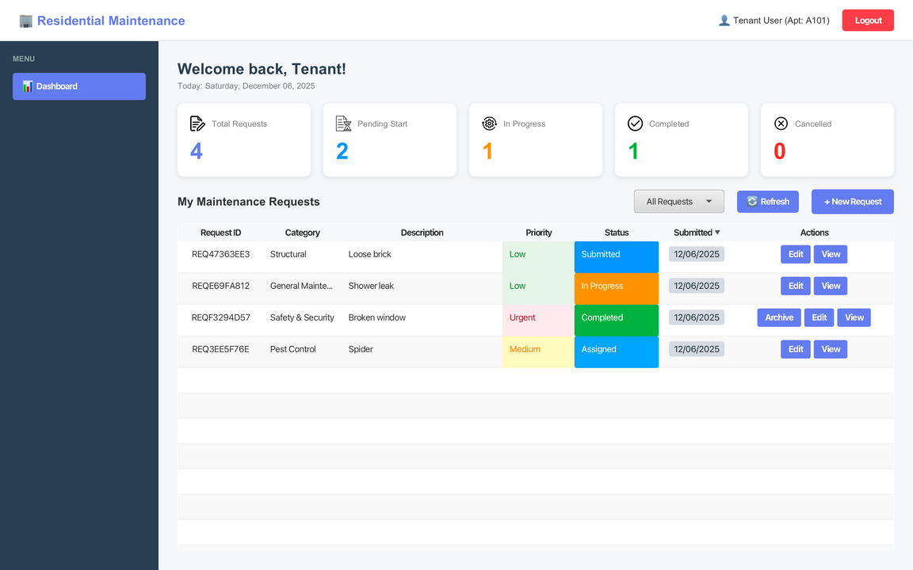
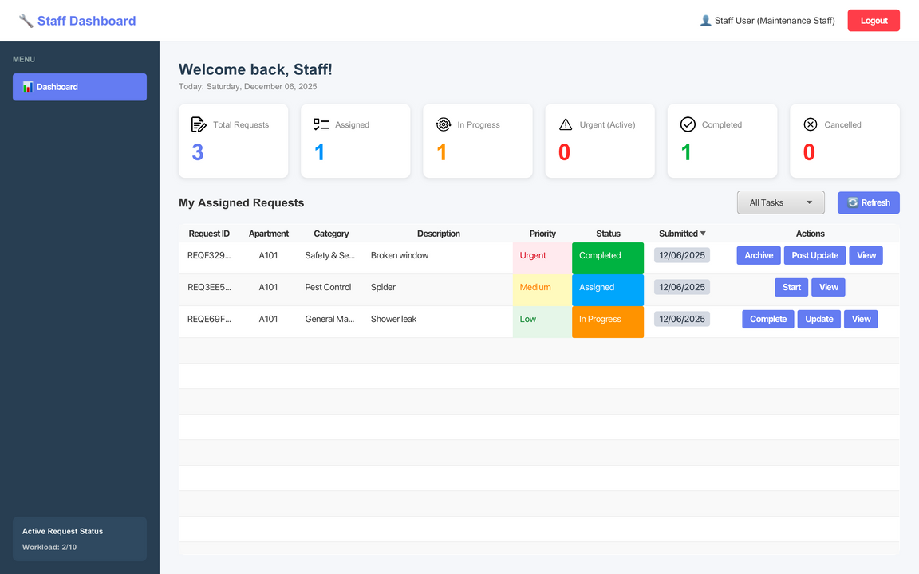
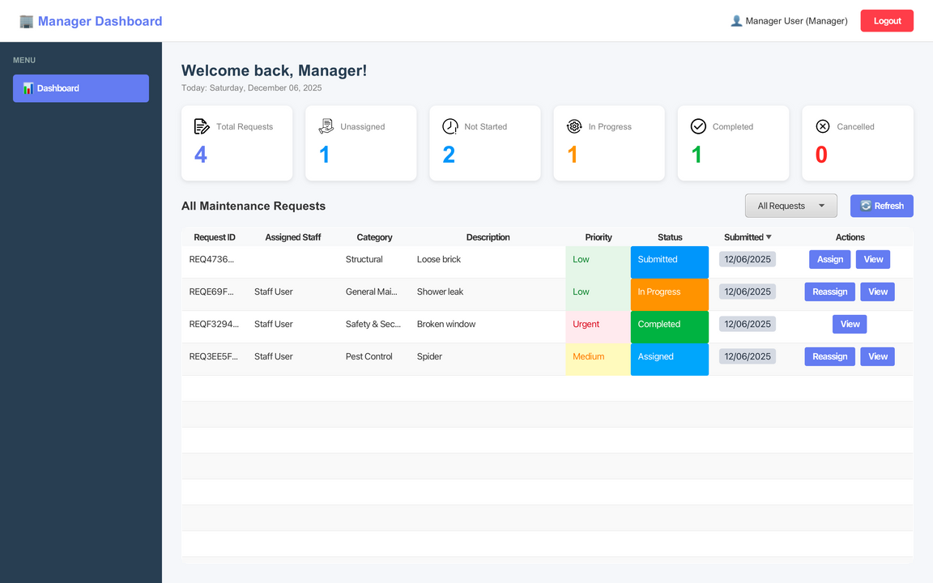
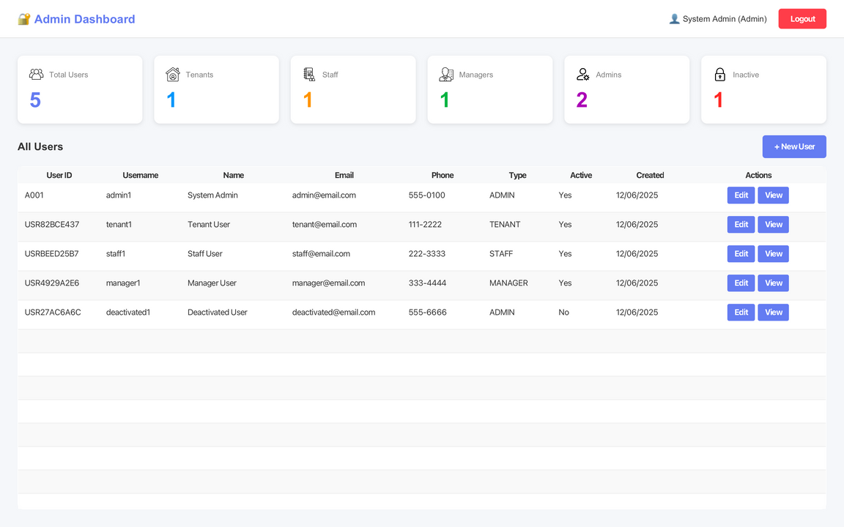
UI: Login, Tenant, Staff, Manager, Admin

Slide 5


Final Features
Unique tenant, staff, manager, and admin dashboards
1
4
Photo upload
2
5
Synchonized request tickets via datbase
Email notification feature
3
Staff updates (automatically sends email)
6
Archive request

Slide 6
Tenant Dashboard
1
3
Improved layout for easier overview (status color)
Create new requests
2
View and edit requests (name, decription, status)
4
Custom request stats

Slide 7
Staff Dashboard
1
3
Improved layout for easier overview (status color)
Resolve requests
2
Update tenants (notifies tenant via email)
4
Custom request stats

Slide 8
Manager Dashboard
1
3
Improved layout for easier overview (status color)
Assign requests
2
4
Custom request stats focus on staff efficiency
Reassign requests

Slide 9
Admin Dashboard
1
Admin users can edit user information
3
Improved layout for easier user management overview
2
Admin users can edit account status(active/deactive)
4
User stats

Slide 10
Email Notifications
1
Sends email when ticket status changes
3
Reduces back and forth communication
2
4
Simple and free to implement
Keeps tenants informed

Slide 11
Staff Update
1
“Staff Update” text box so staff can document progress
3
Improved request detail view to support clearer communication
2
“Resolution” text box for documenting final fixes
4
Automatically send email to tenant

Slide 12
Photo Upload
1
Both tenants and staff can attach pictures to tickets
3
Helps diagnose issues faster
2
Staff can access images in tickets
4
Stored in database

Slide 13
Archive Request
Tenant and staff can each archive a completed or cancelled request on their dashboard
Cleans up dashboard without compromising information
1
3
2
Automatically unarchived if reopenned
4
Archive status stored in database

Slide 14
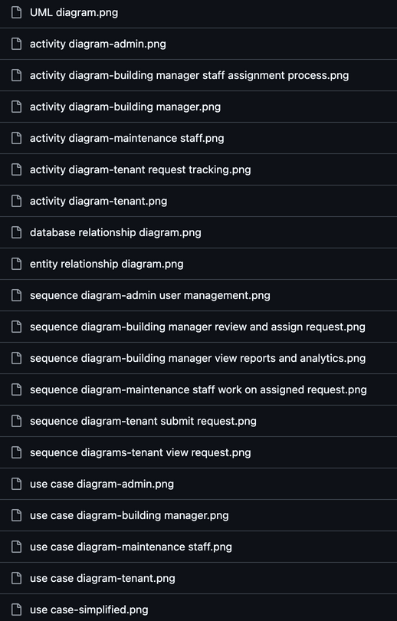

DIAGRAMS
  UML
  Activity
  Database
  Entity Relationship
  Sequence
  Use Case
https://github.com/qperkins33/Residential-Maintenance-Management-System/tree/main/diagrams

Slide 15

Technical Architecture
1
Programming language: Java 21
4
Database:
SQL with JDBC
2
UI Framework:
JavaFX with FXML
5
Testing:
JUint, TestFX
3
Styling:
CSS
6
Methodology:
Agile Scrum

Slide 16
Challenges
Solutions
Store uploaded images in the database and only display image when clicks ‘view’
1
Handling large image uploads
1
2
Syncing notifications across all dashboards
Refresh from the database before interacting with any request
2
3
Testing notification triggers
3
Develop email feature

Slide 17

Project Timeline
Sprint 1
Sprint 2
Sprint 3
Sprint 4
What was accomplished during this iteration?
Tenant, Staff, Manager Dashboards
Photo upload functionality
Admin Dashboard
Staff update feature
Full notification system(email alerts)

Slide 18
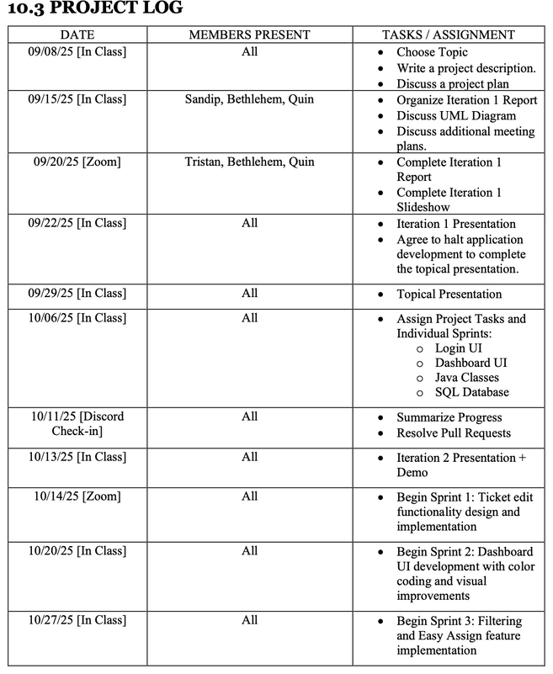
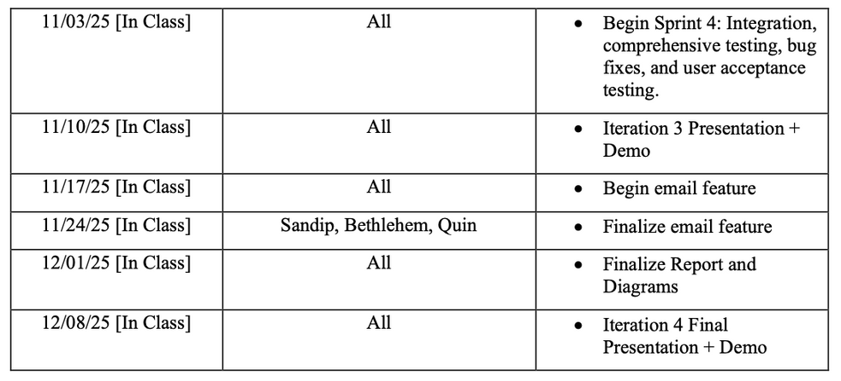
PROJECT LOG

Slide 19
Final Vision
Fully deployable system for property management companies
1
4
Machine learning for completion time estimates
2
Full mobile app version of the system for all users
5
Advanced analytics dashboard for managers and admins
3
Machine learning for ticket categorization
6
Integration-ready platforms with API’s for property management systems

Slide 20


Thank You
Residential Maintenance Management System
Iteration 4 Presentation

